Slide 1
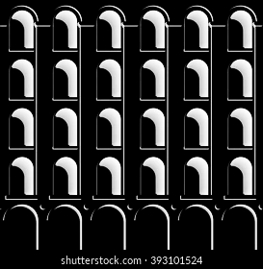

NEO- Salvador Calgua and Irene Martín Luque
MaCAD 2022
Digital Tools for Data Encoding and Machine Learning
Gabriella Rossi and Hesham Shawqy

Slide 2
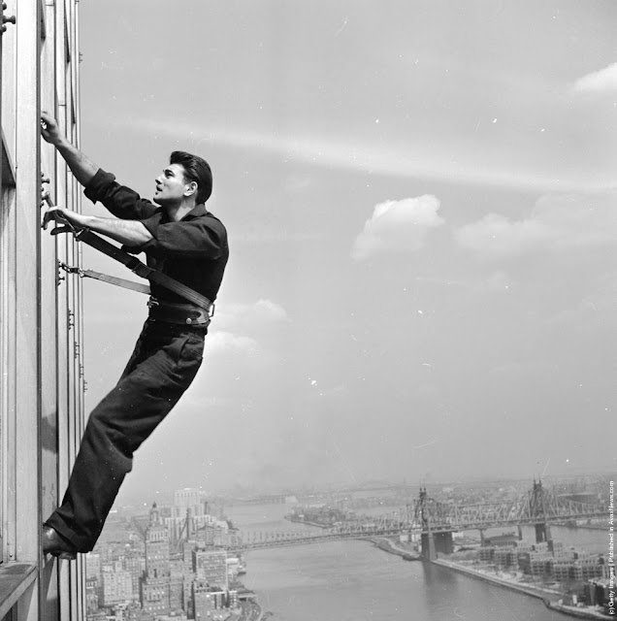
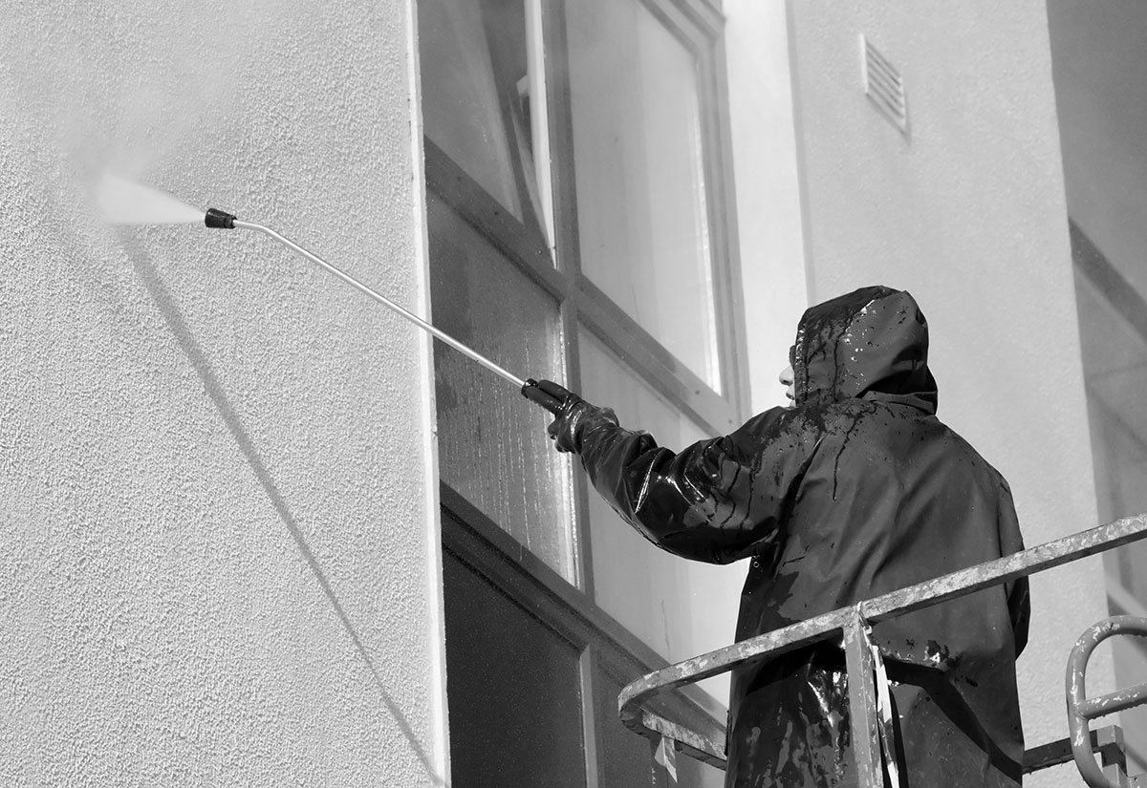
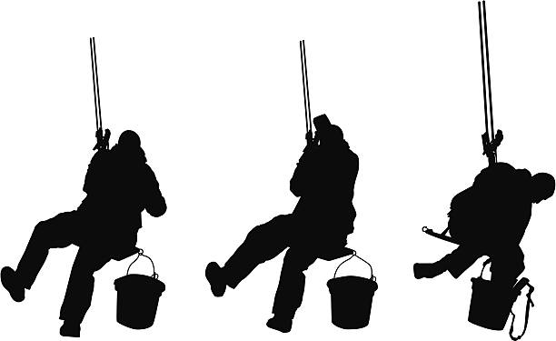
[1]
State of the art
1955
2021
United Nations Secretariat building in mid-town Manhattan, NY, circa 1955
Digital Tools for Data Encoding and ML | MaCAD 2022 | Salvador Calgua and Irene Martín

Slide 3
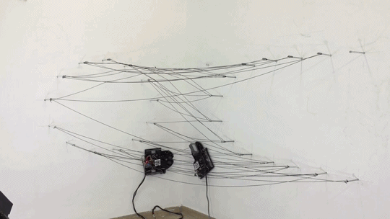
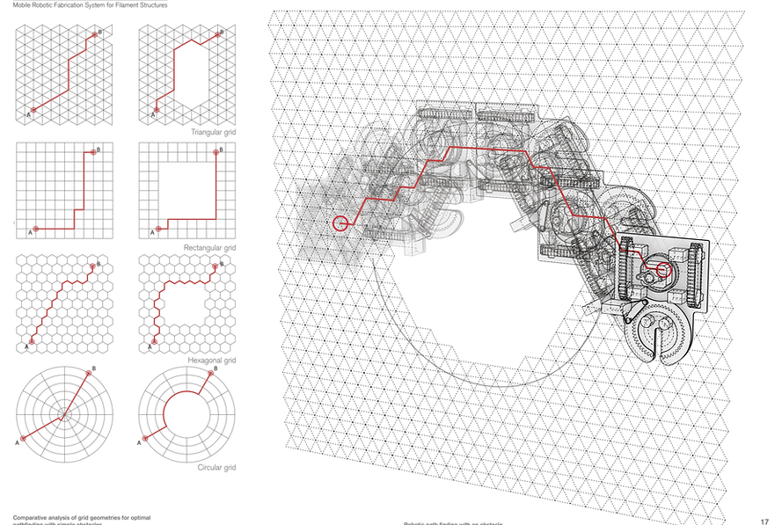
[1]
[2
State of the Art_2
https://www.mariayablonina.com/mobile-robotic-fabrication-system
Digital Tools for Data Encoding and ML | MaCAD 2022 | Salvador Calgua and Irene Martín

Slide 4
[1]
[3
Workflow
DQN:
Train Model
Deployment
Data Exploration:
Extract features
PCA Analysis
Shallow Learning:
Test Regression Models
ANN Regression:
Test different
Architectures
Prediction:
Time
Digital Tools for Data Encoding and ML | MaCAD 2022 | Salvador Calgua and Irene Martín

Slide 5
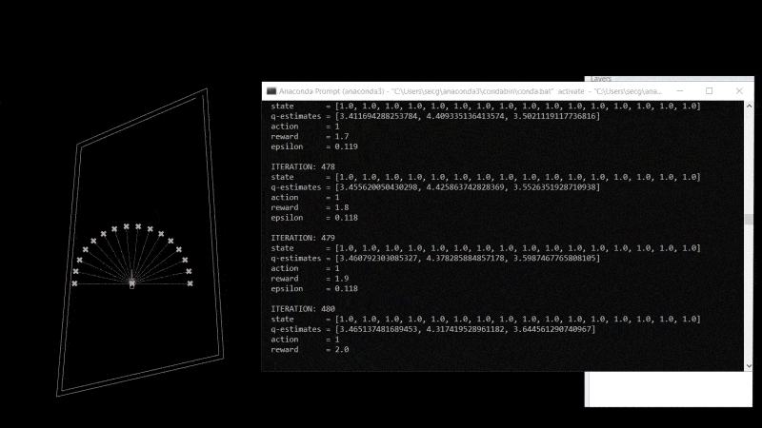
[1]
[4
DQN Training & Deploy
Environment
and
Agent
Layer (type) Output Shape Param #
=================================================================
input_1 (InputLayer) (None, 16) 0
_________________________________________________________________
dense (Dense) (None, 64) 1088
_________________________________________________________________
dense_1 (Dense) (None, 32) 2080
_________________________________________________________________
dense_2 (Dense) (None, 16) 528
_________________________________________________________________
dense_3 (Dense) (None, 3) 51
=================================================================
Total params: 3,747
Trainable params: 3,747
Non-trainable params: 0
https://github.com/NariddhKhean/Grasshopper_DQN/blob/master/README.md
Digital Tools for Data Encoding and ML | MaCAD 2022 | Salvador Calgua and Irene Martín

Slide 6
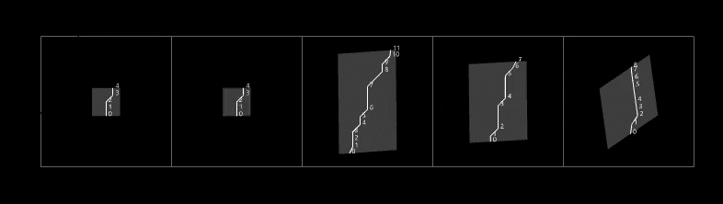
[1]
[4
Data exploration
Windows.- Different sizes all of them with 4 sides
Digital Tools for Data Encoding and ML | MaCAD 2022 | Salvador Calgua and Irene Martín

Slide 7
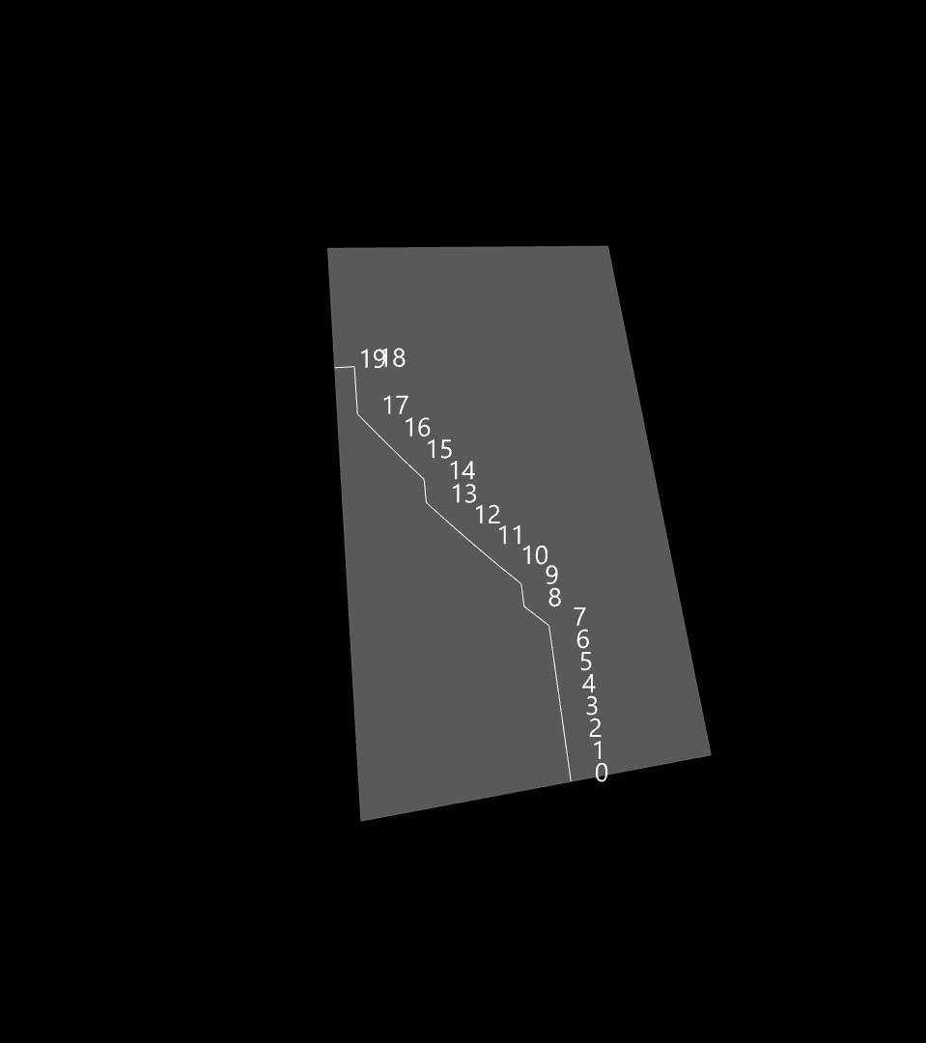
[1]
[4
Data exploration
p_b
(x_b, y_b)
p_a
(x_a, y_a)
area
clean_area
per_clean_area
steps
time .- clean 0.25/minute
height
width
x_a, y_a
x_b, y_b
x_c, y_c
x_d, y_d
p_a
p_b
p_c
p_d
bin.-
boolean values
%clean area > 0.35
height
p_d
(x_d, y_d)
p_c
(x_c, y_c)
width
Digital Tools for Data Encoding and ML | MaCAD 2022 | Salvador Calgua and Irene Martín

Slide 8
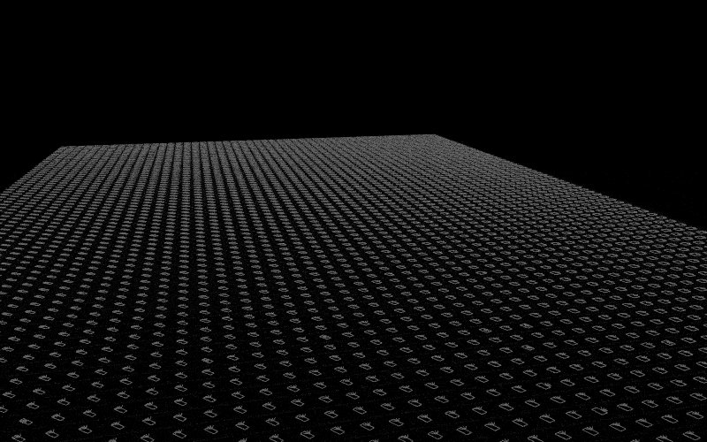
[1]
[4
Data exploration
p_a
(x_a, y_a)
0 area 5000 non-null float64
1 clean_area 5000 non-null float64
2 per_clean_area 5000 non-null float64
3 steps 5000 non-null int64
4 time 5000 non-null float64
5 height 5000 non-null float64
6 width 5000 non-null float64
7 x_a 5000 non-null float64
8 x_b 5000 non-null float64
9 x_c 5000 non-null float64
10 x_d 5000 non-null int64
11 y_a 5000 non-null int64
12 y_b 5000 non-null float64
13 y_c 5000 non-null float64
14 y_d 5000 non-null float64
15 p_a 5000 non-null float64
16 p_b 5000 non-null float64
17 p_c 5000 non-null float64
18 p_d 5000 non-null float64
19 bin 5000 non-null int64
Digital Tools for Data Encoding and ML | MaCAD 2022 | Salvador Calgua and Irene Martín

Slide 9
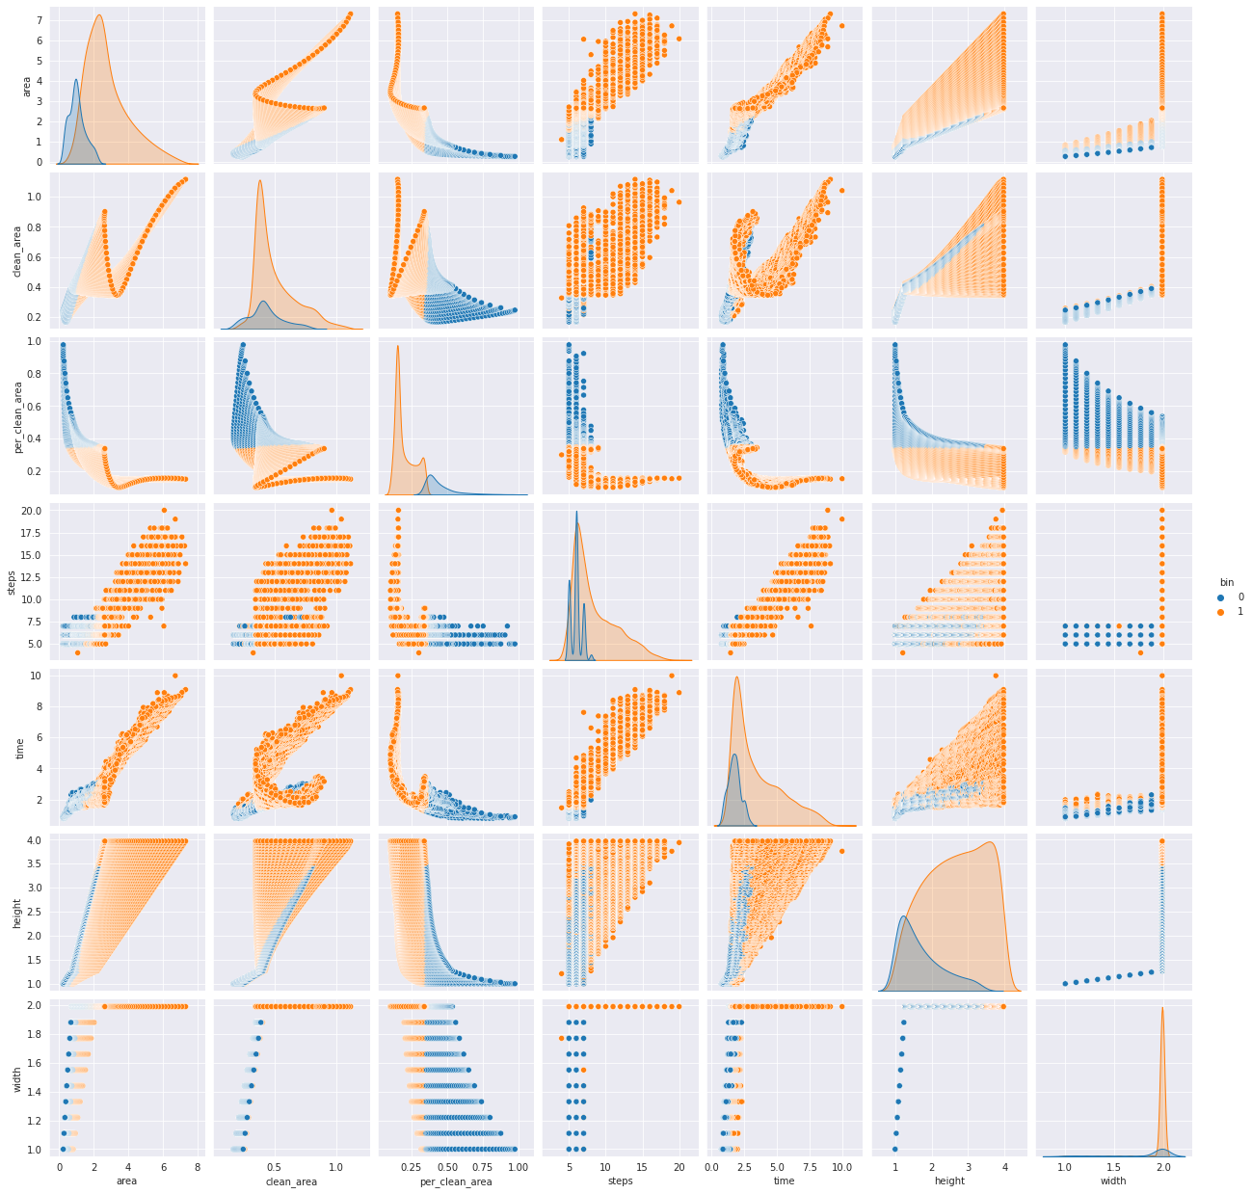
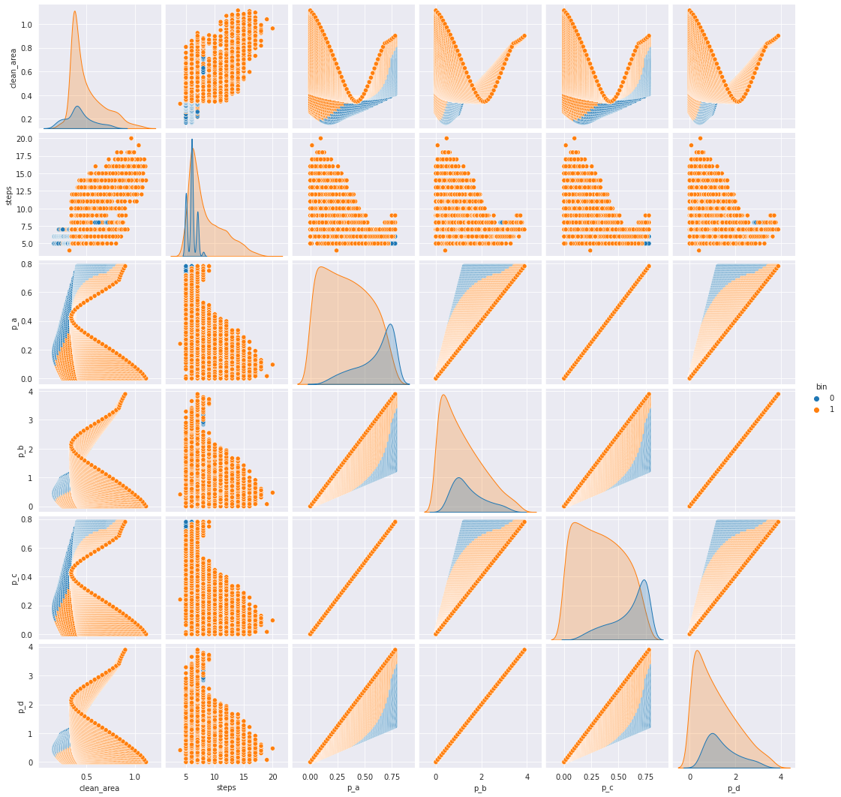
[1]
[4
Data exploration
p_a
(x_a, y_a)
Digital Tools for Data Encoding and ML | MaCAD 2022 | Salvador Calgua and Irene Martín

Slide 10
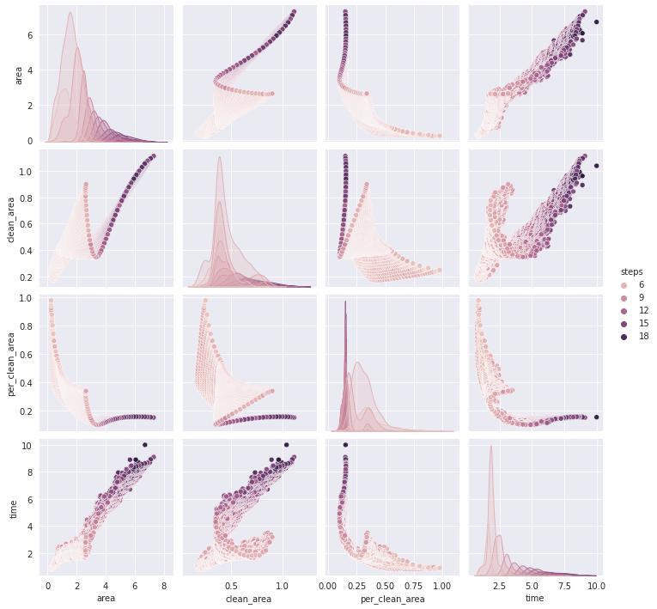
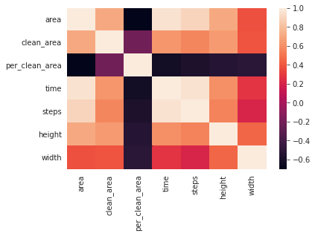
[1]
[4
Data exploration
p_a
(x_a, y_a)
Digital Tools for Data Encoding and ML | MaCAD 2022 | Salvador Calgua and Irene Martín

Slide 11
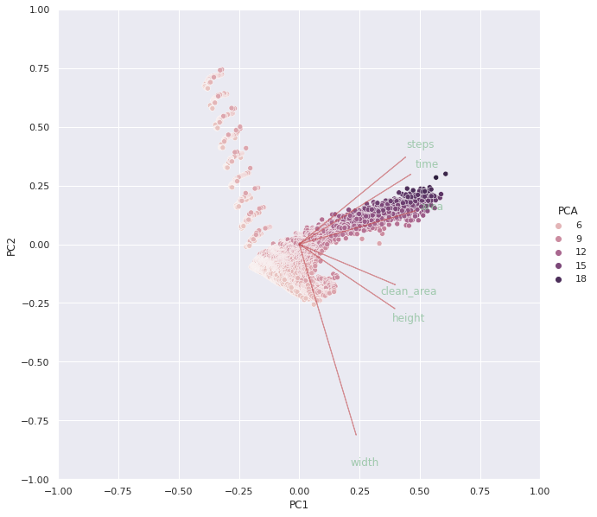
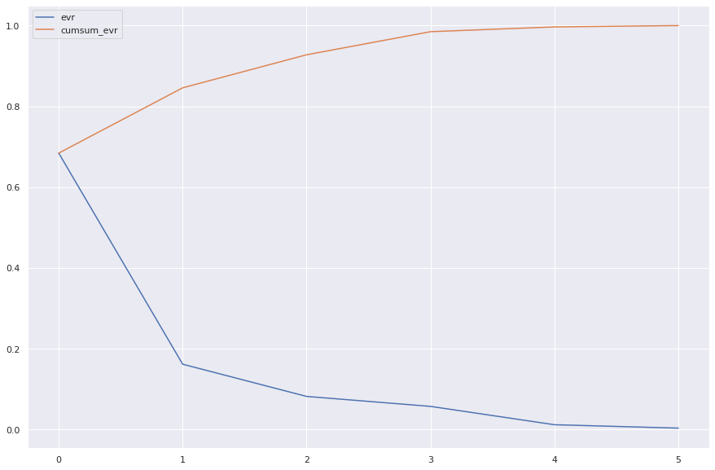
[1]
[4
Data exploration
p_a
(x_a, y_a)
Digital Tools for Data Encoding and ML | MaCAD 2022 | Salvador Calgua and Irene Martín

Slide 12
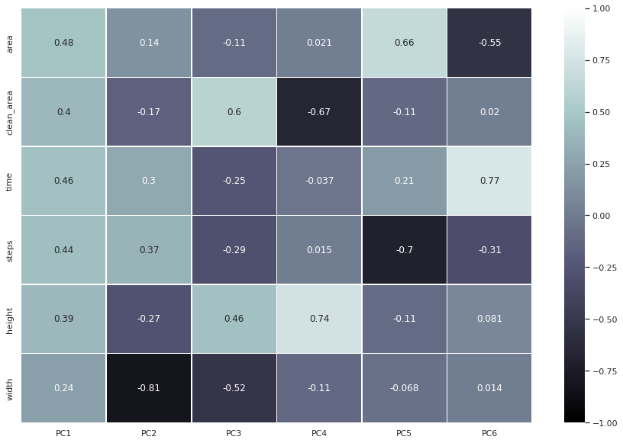
[1]
[4
Data exploration
p_a
(x_a, y_a)
area | clean_area | time | steps | height | width
[0.68426793 0.1616216 0.08183901 0.05717743 0.01176494 0.00332908]
0 PC0 area
1 PC1 width
2 PC2 clean_area
3 PC3 height
4 PC4 steps
5 PC5 time
Digital Tools for Data Encoding and ML | MaCAD 2022 | Salvador Calgua and Irene Martín

Slide 13
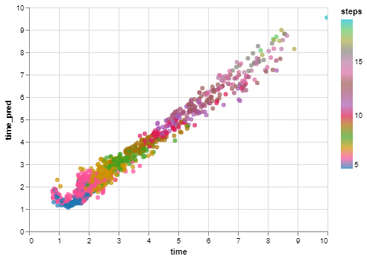
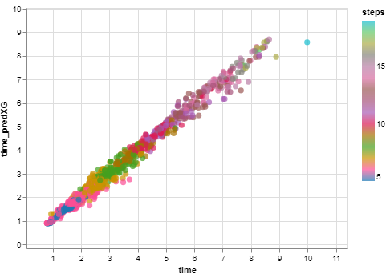
[1]
[5
Shallow Learning
LinearRegression
XGBRegressor
test_size = 0.25, random_state = 45
Data = area, clean_area, per_clean_area, steps
# Define the dependant variable / target to predict
y_reg = data.time
0.9679723312449333
Model_Performance
0.9871792765302982
Model_Performance
Digital Tools for Data Encoding and ML | MaCAD 2022 | Salvador Calgua and Irene Martín

Slide 14
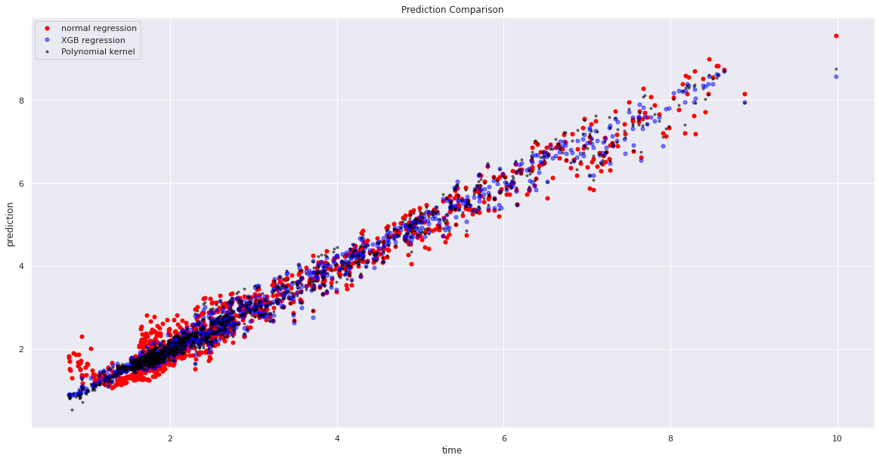
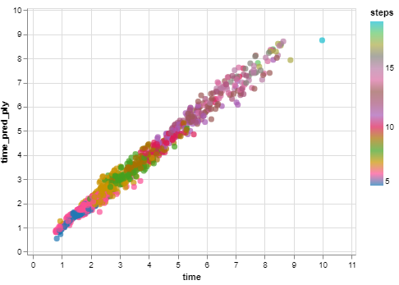
[1]
[5
Shallow Learning
Kernel_Ridge.- Degree = 3 Polynomial Kernel
test_size = 0.25, random_state = 45
Data = area, clean_area, per_clean_area, steps
# Define the dependant variable / target to predict
y_reg = data.time
0.9850316706339624
Model_Performance
Comparison.- Linear, XGBRegressor, Polynomial Kernel
Digital Tools for Data Encoding and ML | MaCAD 2022 | Salvador Calgua and Irene Martín

Slide 15
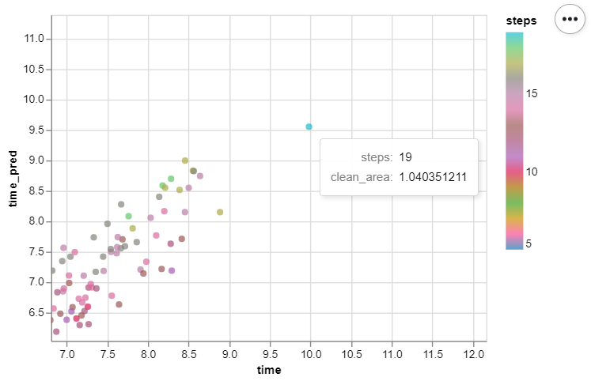
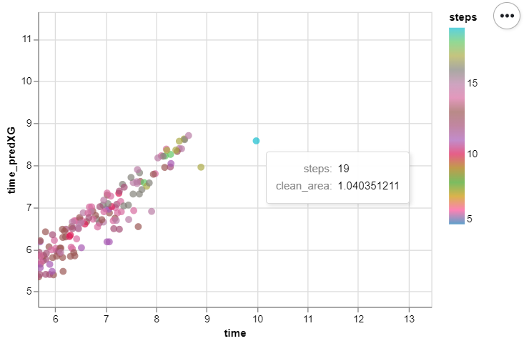
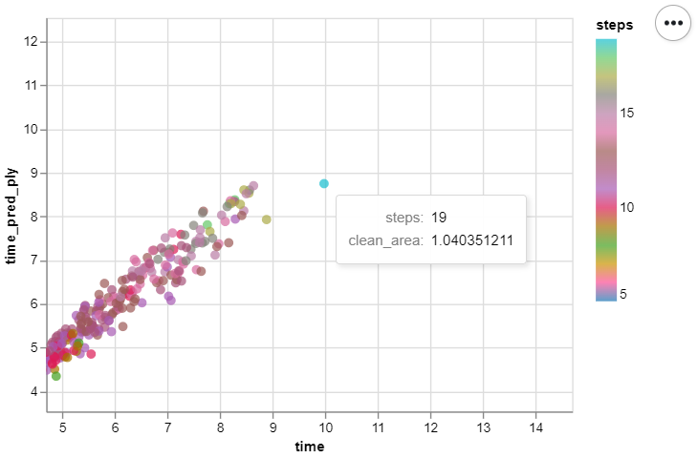
[1]
[5
Shallow Learning
LinearRegression
XGBRegressor
Kernel_Ridge.
Digital Tools for Data Encoding and ML | MaCAD 2022 | Salvador Calgua and Irene Martín

Slide 16
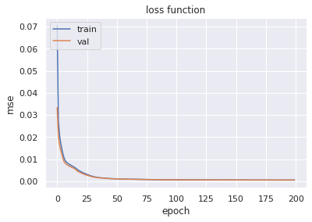
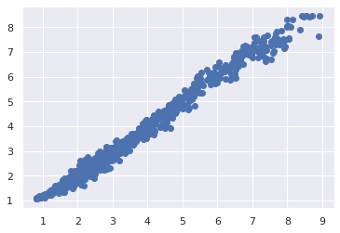
[1]
[6
ANN Regression
Model: "sequential_15"
_________________________________________________________________
Layer (type) Output Shape Param #
=================================================================
dense_132 (Dense) (None, 2) 14
dense_133 (Dense) (None, 4) 12
dense_134 (Dense) (None, 4) 20
dense_135 (Dense) (None, 4) 20
dense_136 (Dense) (None, 2) 10
dense_137 (Dense) (None, 2) 6
dense_138 (Dense) (None, 4) 12
dense_139 (Dense) (None, 2) 10
dense_140 (Dense) (None, 2) 6
dense_141 (Dense) (None, 1) 3
=================================================================
Total params: 113
Trainable params: 113
Non-trainable params: 0
y_pred
mse_test: 0.0005295599694363773
y_truth,
Time
Digital Tools for Data Encoding and ML | MaCAD 2022 | Salvador Calgua and Irene Martín

Slide 17
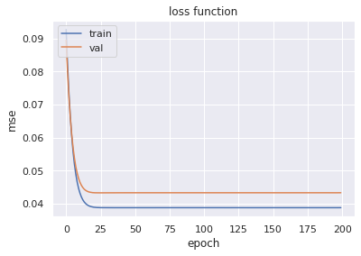
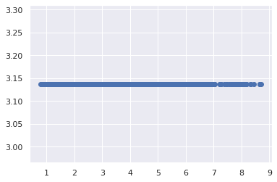
[1]
[6
ANN Regression
Model: "sequential_31"
_________________________________________________________________
Layer (type) Output Shape Param #
=================================================================
dense_195 (Dense) (None, 2) 14
dense_196 (Dense) (None, 4) 12
dense_197 (Dense) (None, 4) 20
dense_198 (Dense) (None, 4) 20
dense_199 (Dense) (None, 4) 20
dense_200 (Dense) (None, 2) 10
dense_201 (Dense) (None, 1) 3
dense_202 (Dense) (None, 5) 10
dense_203 (Dense) (None, 3) 18
dense_204 (Dense) (None, 1) 4
=================================================================
Total params: 131
Trainable params: 131
Non-trainable params: 0
y_pred
y_truth,
mse_test: 0.036974821239709854
Time
Digital Tools for Data Encoding and ML | MaCAD 2022 | Salvador Calgua and Irene Martín

Slide 18
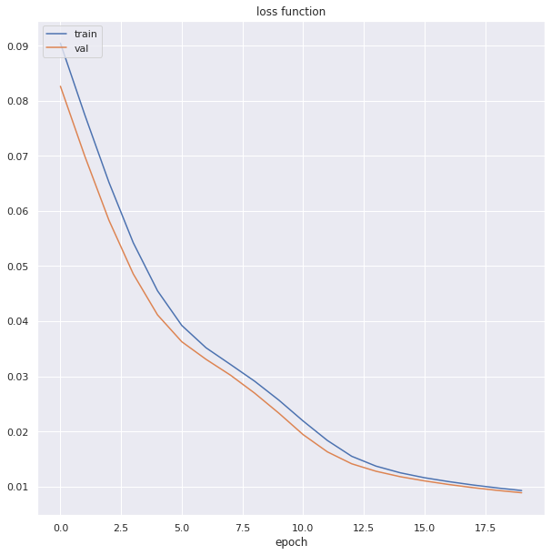
[1]
[7
ANN Prediction and Deployment
Model: "sequential_2"
_________________________________________________________________
Layer (type) Output Shape Param #
=================================================================
dense_16 (Dense) (None, 2) 8
dense_17 (Dense) (None, 4) 12
dense_18 (Dense) (None, 4) 20
dense_19 (Dense) (None, 2) 10
dense_20 (Dense) (None, 2) 6
dense_21 (Dense) (None, 1) 3
=================================================================
Total params: 59
Trainable params: 59
Non-trainable params: 0
Time
mse_test: 0.036974821239709854
Digital Tools for Data Encoding and ML | MaCAD 2022 | Salvador Calgua and Irene Martín

Slide 19
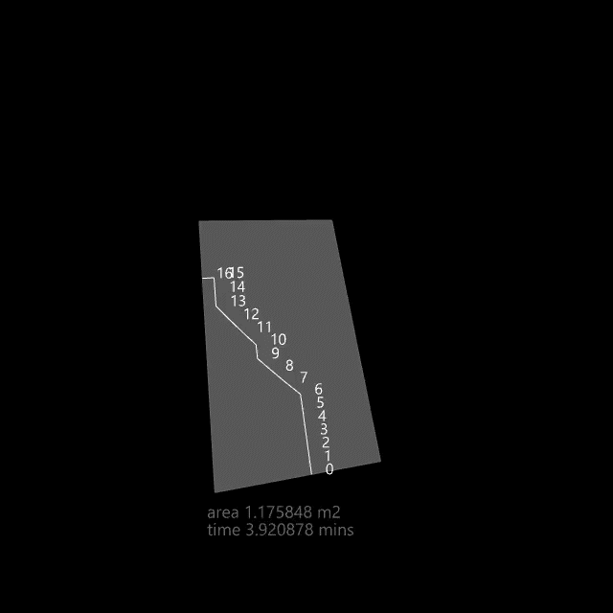
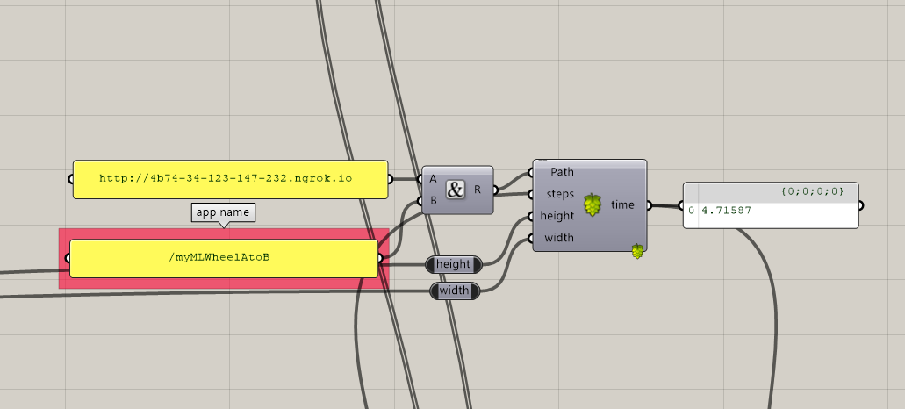
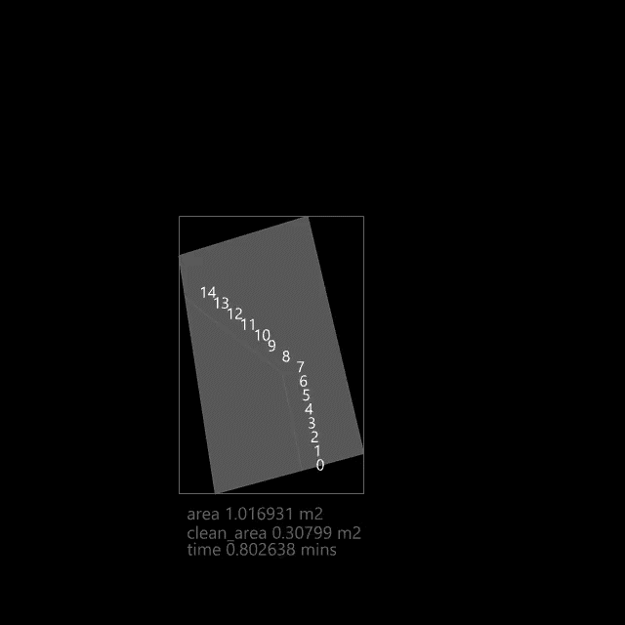
[1]
[7
ANN Prediction and Deployment
prediction screenshot
width and height variation
Digital Tools for Data Encoding and ML | MaCAD 2022 | Salvador Calgua and Irene Martín

Slide 20
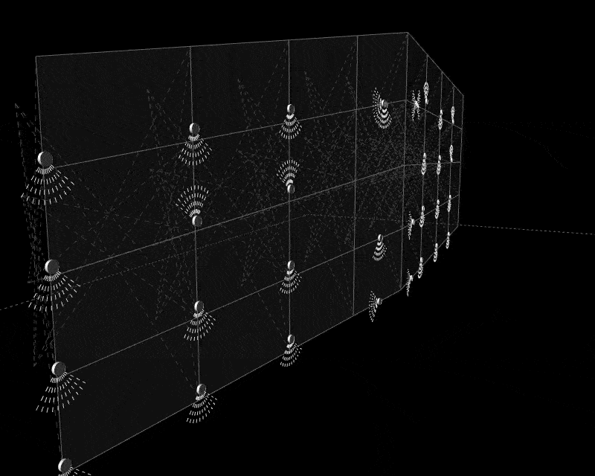
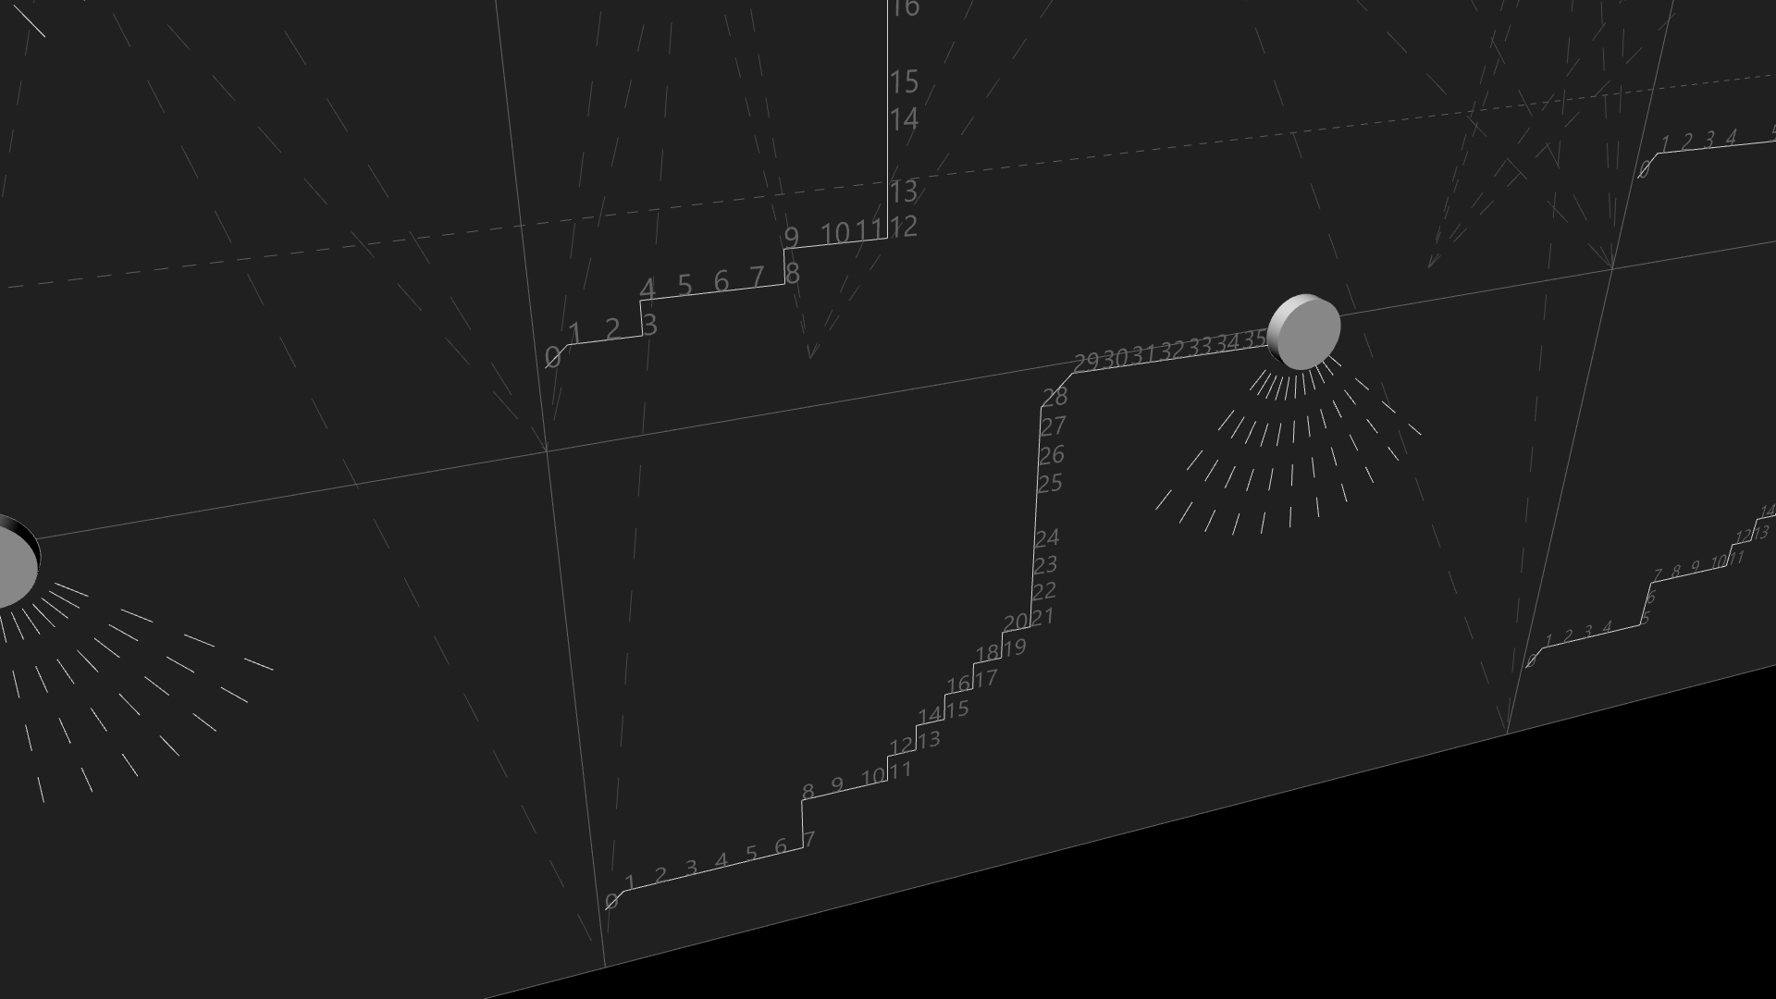
[1]
[7
p_a
(x_a, y_a)
ANN Prediction and Deployment
Digital Tools for Data Encoding and ML | MaCAD 2022 | Salvador Calgua and Irene Martín

